Slide 1

Presentation&Demo
Team#23
kingsback
20186557WuTong&20184920MaXinyu
NOV27th--DEC4th

Slide 2


Slide 3
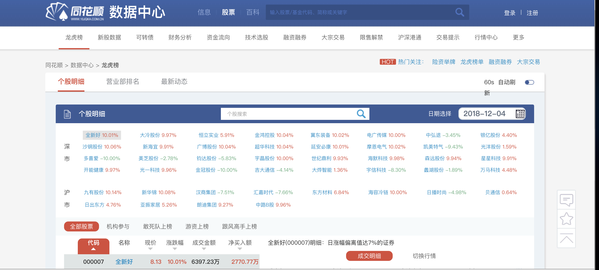
idea

Slide 4


Tools for database

Slide 5



web service

Slide 6
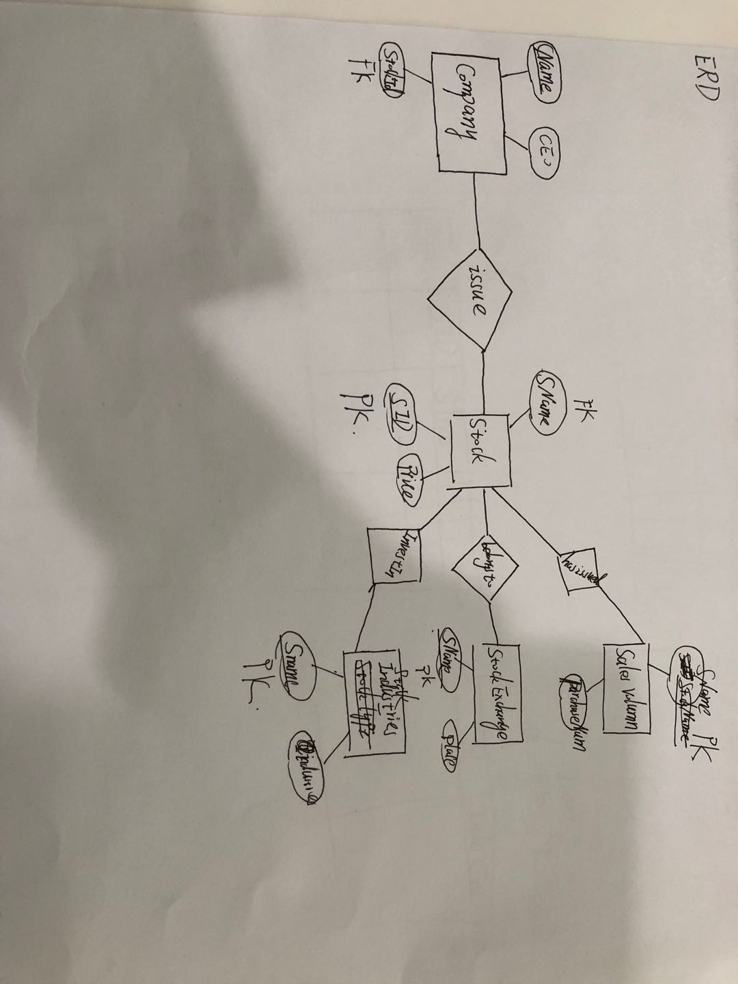
ER Diagram

